Slide 1
Scrum - Estimation and Planning
Dr.HUSSAIN SYED

Slide 2
Why estimate?
To help us make trade-off decisions. Two BIG factors to consider – Time and Budget
To help set goals - the act of estimating and setting targets can certainly help
you to maintain focus and maximize results.
“WE HUMANS ARE NOT NATURALLY GREAT ESTIMATORS. WE TEND TO EITHER BE OPTIMISTS OR PESSIMISTS AND VERY RARELY REALISTS.”

Slide 3
Relative Estimation
So we're bad at absolute estimates. It turns out however that we're pretty reasonable at relative estimates.
Relative estimation applies the principle that comparing is much quicker and more accurate than deconstructing.
Teams compare the relative effort of completing a new requirement to the relative effort of a previously estimated requirement.

Slide 4
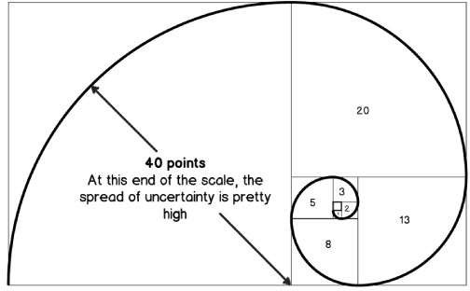
Relative Estimation
Planning Poker - a game invented by James Greening and popularized by Mike Cohn
Mike Cohn’s modified Fibonacci sequence (Story Points):
1/2, 1, 2, 3, 5, 8, 13, 20, 40, 100, ∞(infinity)
Ideal Hours
T-shirt sizes

Slide 5
Estimation - Basic Principles
Estimates should be created by the team and NOT by the most senior developer
You need estimates before you can prioritize
Estimates are NOT commitments
Every estimate should come with a probability
Estimates should be of relative, rather than absolute, size
3 levels of precision (Story estimates, Task estimates, Task remaining work)
Relative estimates on story level and above
Hour estimates on task level
“IT’S BETTER TO BE ROUGHLY RIGHT THAN PRECISELY WRONG.” – JOHN MAYNARD KEYNES

Slide 6
Release Planning

Slide 7
What’s a good plan?
A good plan is one that supports reliable decision-making
Will go from
We’ll be done in the third quarter
We’ll be done in August
We’ll be done August 18th

Slide 8
Planning - Purpose
To answer questions such as:
How much will be done by September 30?
When can we ship with this set of features?
How many people or teams should be on this project?

Slide 9
Velocity
The amount of work completed in an iteration.
Measured in the units you use to estimate product backlog items (usually Story Points or Ideal Hours)
Not a prediction of exactly how much work will be completed in each iteration.
“64% OF THE FEATURES ARE RARELY/ NEVER USED. 20% ARE OFTEN/ ALWAYS USED.” - STANDISH GROUP STUDY REPORTED AT XP2002 BY JIM JOHNSON

Slide 10
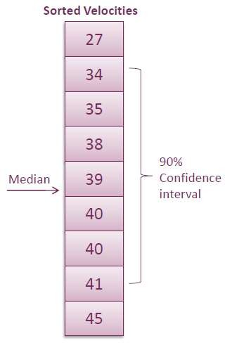
Velocity Calculation
Median = {(n + 1) ÷ 2}^{th} value
= (7+1) / 2
= 4th value (i.e. 39)

Slide 11
Fixed-date Planning
How much can I get by <date>?
Determine how many sprints you have.
Measure or estimate velocity as a range.
Multiply low velocity x number of sprints (Count off that many points, These are “Will Have” items).
Multiply median velocity x number of sprints (Count off that many more
points, These are “Might Have” items).
Multiply high velocity x number of sprints (Count off that many points, These are “Won’t Have” items.
“AGILE DEVELOPMENT IS AN ART OF MAKING THE IMPOSSIBLE POSSIBLE”

Slide 12
Fixed-scope Planning
When will all of this be done?
Sum all the backlog items the customer needs.
Measure or estimate velocity as a range.
Divide total story points by high velocity - This is the “shortest” number of sprints it could take.
Divide total story points by low velocity - This is the “most” number of
sprints it could take.
“IN SCRUM WE START BUILDING THE PRODUCT EVEN BEFORE WE HAVE DETAILED ALL REQUIREMENTS”

Slide 13
Ranges
Notice in both cases we had a range
For a fixed date project, use a scope range: “By that date you’ll have all of these features and some of these.”
For a fixed scope project, use a date range: “It will take us between 5 and 8 sprints to deliver all of those features.”

